Slide 1
Final Project
By Chantal CHoi

Slide 2
Partner: ASIAN TASK FORCE AGAISNT DOMESTIC VIOLENCE
ATASK is a nonprofit, community organization serving Pan-Asian survivors of domestic and intimate partner violence. They provide services in Greater Boston and Greater Lowell and offer limited assistance in other cities throughout Massachusetts and New England. ATASK’s Legal Advocacy Program helps fill the critical gap of legal needs for victims of domestic violence of Asian heritage who do not traditionally access mainstream legal services programs due to linguistic and cultural barriers. Often, in their countries of origin, clients may have experienced fear of the government, law enforcement or legal systems. The in-house program attorney and legal coordinator works closely as a team with our well-trained first generation immigrant DV Advocates to deliver high-quality comprehensive and strategic legal services that complement our shelter, stabilization, income-maintenance and safety-planning services . This highly coordinated language and cultural-specific response to complex legal issues assists survivors in their journey to become independent and free from victimization.

Slide 3
Issue #1
Repetitive form filling for immigration petitions like VAWA, U-visa and Petitions.
Naturalization forms

Slide 4
ISSUE #2
Protected and centralized spreadsheet for program attorney to keep clients’ information and client’s notes.

Slide 5
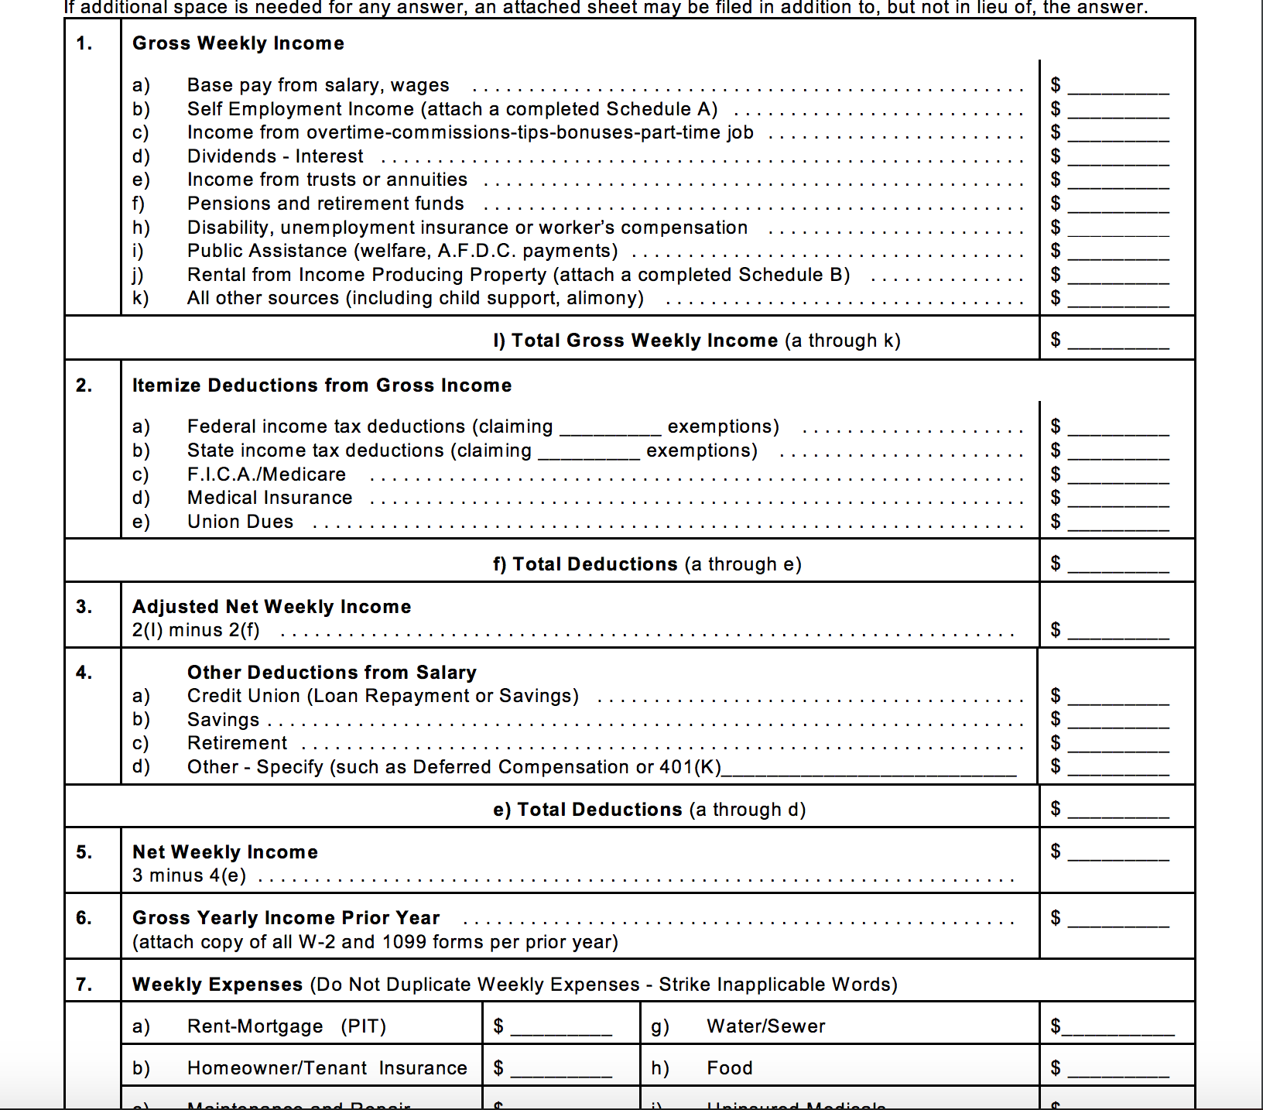
ISSUE #3
Long and complicated financial statement for court proceedings

Slide 6
USERS
Who are they?
Limited English to no English proficiency clients
Bi-lingual advocates
Program Attorney
Current Available Options:
Advocates and Program attorneys manually inputting information
Advocates spend about half an hour working with clients and explaining the financial statement.

Slide 7
SOLUTION
Using QnA that would allow clients to input personal information before meeting with Program Attorney.
Using mail merge to fill out immigration documents that are repetitive.
Using QnA with translated versions to fill out financial statement and naturalization form.

